Slide 1
Advanced Topics
WEB SCIENCES
Etienne Raquin
11.06

Slide 2


How is
Mental Health impacted by
Physical Activities Monitoring ?

Slide 3

“If you’re crazy about Strava”
- Dr. Koumpis, 14.05.2019

Slide 4
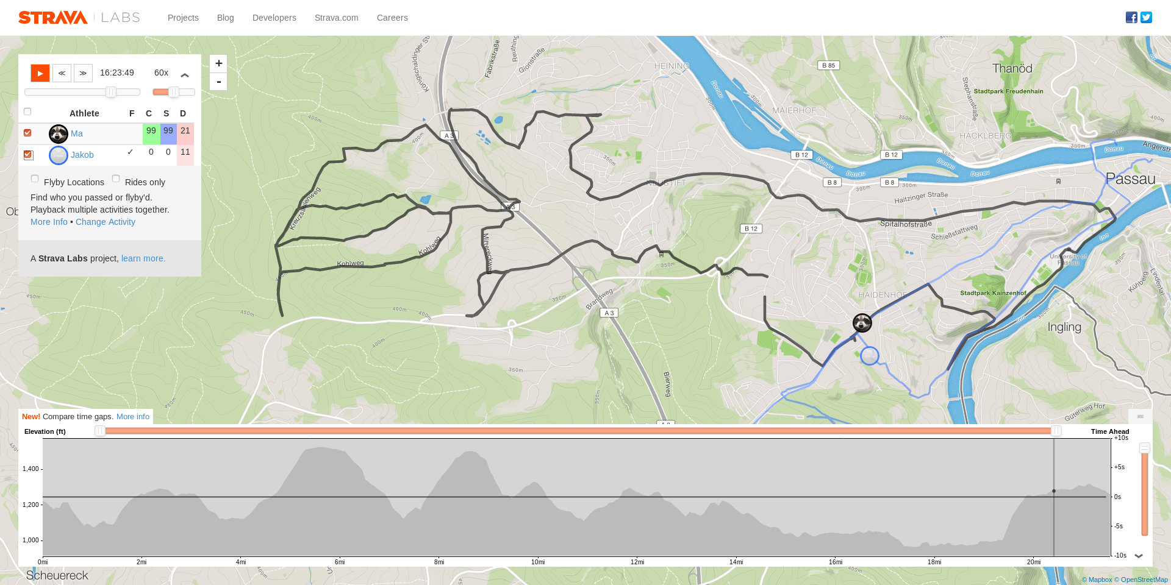
FlyBy
Link

Slide 5
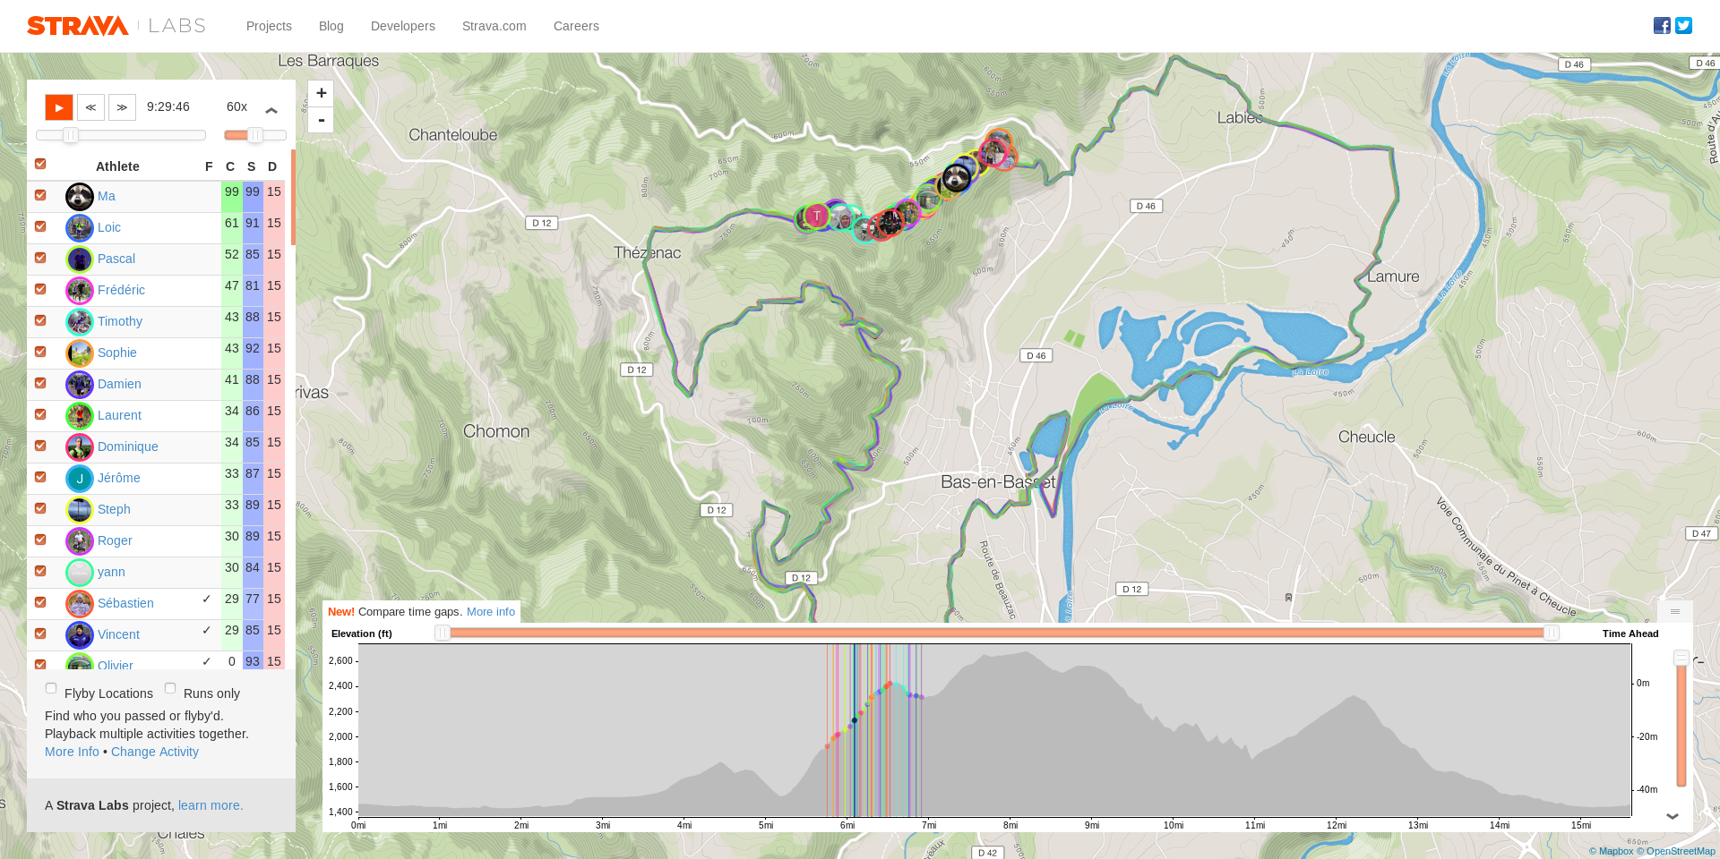
FlyBy
Link

Slide 6
HEALTH
“It would be great
if you could do something
related to health”
- Dr. Koumpis, 14.05.2019

Slide 7
Mental Health

Slide 8


Mental Health
https://www.youtube.com/watch?v=TUtmvIEhfe8

Slide 9

Sarah True
Professional triathlete
2 times olympian champion
Spiral of depression

Slide 10

Matt Pritchard
UK TV show star
Drugs, alcohol, depression
Found triathlon

Slide 11

"Pressures of training
for and racing a triathlon
Can build up
and become overwhelming
But on the flip size,
swimming, cycling, and running
Actually act as an escape
from the pressure of everyday life"

Slide 12

"Very common to experience depression post event"
"There is totally a correlation between overtraining and depression"

Slide 13
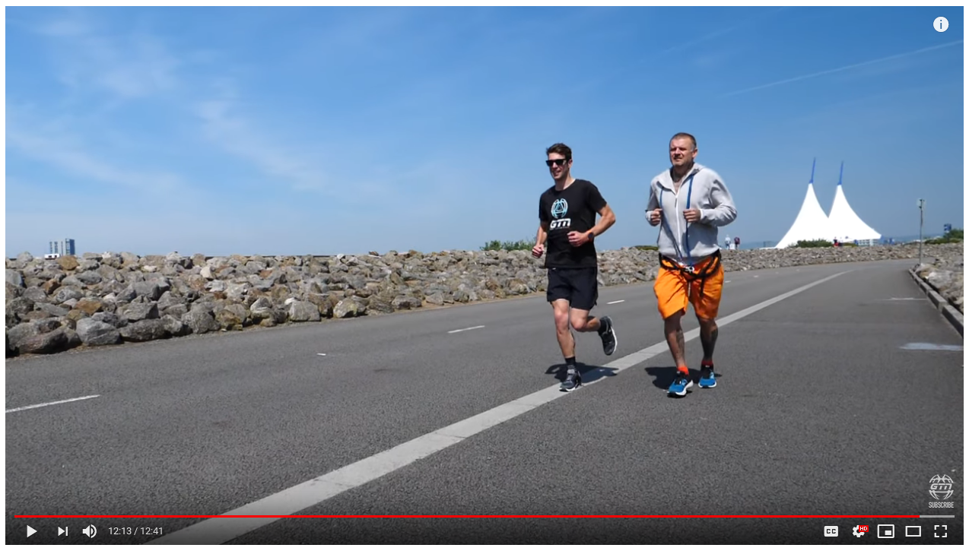
"Try to keep myself busy
so if I never are busy I overthink"

Slide 14
Internet Activity

